Slide 1

The giver
By: LOIS lowery
PRESENTATION hunter Perkins

Slide 2
Table of Contents
Slide 1-Summary
Slide 2-Plot Chart
Slide 3-Setting
Slide 4-Main Character,(Traits, Influences, And point of view)
Slide 5-Main Conflict
Slide 6-Theme#1
Slide 7-Theme#2
Slide 8-Theme#3
Slide 9-The giver compared too...
Slide 10-Most impactfull signpost

Slide 3
“The Giver”, summarization
The giver is a Non-Fiction/ Sci-fi, it takes place in a futuristic society where everyone lives sameness, or they don’t see or experience color, memories, race, religion, based on the fact that the elders/government says this create controversy which leads to basic emotions that are negative like sadness and anger. Jonas becoming 12, is assigned a ,”Honorable” job, receiver of memory. The Giver must teach Jonas memories of the past to provide guidance for the elders but there's a twist. Jonas learning about these new emotions makes the decision to leave the community to try to release the memories, on the journey he must also take Gabriel to keep him alive. The book ends with Jonas sledding down a hill about to release the memories.

Slide 4
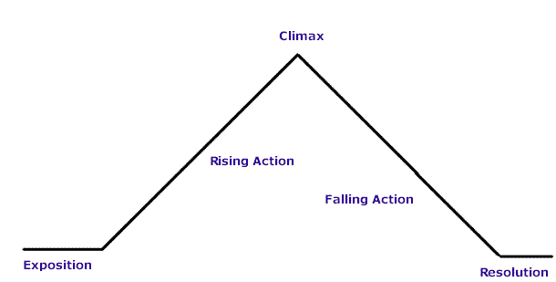
Plot Diagram
Jonas is overwhelmed with reality and leaves the community with Gabe.
Time goes by, Jonas learns about emotions and colors. But after he begins to experience bad memories of war and then learns about release.
Jonas sees the search planes looking for him, Jonas Gives Gabriel memories to survive.
Jonas is Assigned “Receiver of memory”, he gets his first memory of sledding.
Jonas and Gabriel are sledding downhill to a community.
Jonas sees flashes of colors and wonders what it is.
Jonas has a normal life.
The Resolution: Jonas Leaves the community to keep Gabriel safe.

Slide 5
Setting
World-Earth
Place-Community(Unknown Location or what community)
Time- Over the course of 1 year-2 year (Over the course of Jonas’s 12th year)
Tone
The community is very secretive, hiding stuff about the past and what things really are,( Example:Release)

Slide 6
Main Character,(Traits, Influences, And Point of View)
Jonas is a 12 year old boy, he has different eyes from others in the community, he is very friendly and honest but soon lets his Job effect his emotions, it makes him Secretive, shy, and he begins to lie. The Giver influences him by giving him memories that changes his point of view of the community. He first believed that the community was a normal place telling everything that citizens need to know but it changes as he learns about emotions, he figures what things are and what the community really is. He finds it in his best interest to take action based on the information that he learns.

Slide 7

Main Conflict
The conflict is a mixture of Man Vs man, and man Vs himself. Jonas is having a internal conflict dealing with all these new emotions and memories but at the same time dealing with the fact that the community is killing babies and elders that don’t fit basic standards to live. It is them he must go against the community to save one who he loves, Gabriel. On page 51, Jonas first learns about release and wants to stay with the giver to talk about why Release is need, per say. It is then he decides to leave the community to save Gabe.

Slide 8


Theme #1, fitting in
Jonas Fits in the community until he receives the new Position, Receiver of Memory. He then has trouble Fitting in sense he is now so different and isolated from others. He soon learns that it is sort of a blessing because he then gets to experience many wonderful memories that makes him forget about it and "fitting In", doesn't matter.

Slide 9

Theme #2, History Matters
Imagine that all of a sudden the person closest to you cannot remember anything. What memories would you share with him? What would you want that person to know about himself, you, your relationship, and the world around him? In The Giver by Lois Lowry, it is not just one person who has lost touch with his past, but an entire community of people. As Jonas, the new Receiver of Memory for the community, begins to gain knowledge of the past, he learns about the relationship between pleasure and pain, the importance of individuality over conformity, and the value and limitations of memories. Keep reading to learn more about these themes in the novel. A theme is a point that the author is trying to make through the story.

Slide 10

Theme#3, The importance of memory
One of the most important themes in The Giver is the significance of memory to human life. Lowry was inspired to write The Giver after a visit to her aging father, who had lost most of his long-term memory. ... To do so, they had to give up the memories of their society's collective experiences

Slide 11
The Giver is like...
The giver in my opinion is like The hunger Games from a setting perspective both take place in futuristic societies, were governments cancel things out from its people for the greater good in their opinion. In reality they are actually the bad guys.

Slide 12
The most impactful SignPost
The most impactful signpost of the giver is the "AHA MOMENT", when jonas figures out what a ,"release' actually is. This makes jonas wonder what if the community is doing the wrong thing which he concludes by leaving the community realizing that killing babies and elders is not right.

Slide 13

Conclusion
The most memorable aspect of the giver is how bad life is without memories and feelings, how things are lifeless and dull. This novel is important cause it shows the importance of things and how little things taken away can have big impacts on people. I recommend this book to my dad because the way he and I have the same taste in literature, he would have as good as a time I did reading this book.

